Slide 1
Don’t Make Me Think!
Steve Krug’s #1 rule for web design.

Slide 2
Why is this important?
“Making pages self-evident is like having good lighting in a store: it just makes everything seem better.” Krug, p. 19
“puzzling over things tends to sap our energy and enthusiasm -and time.” Krug, p.19
Sometimes true that competition is just one click away.

Slide 3
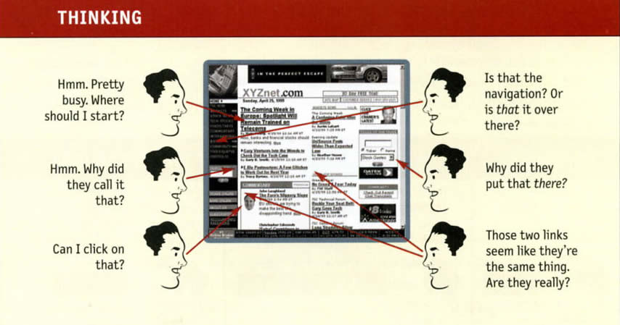
What makes me think?

Slide 4
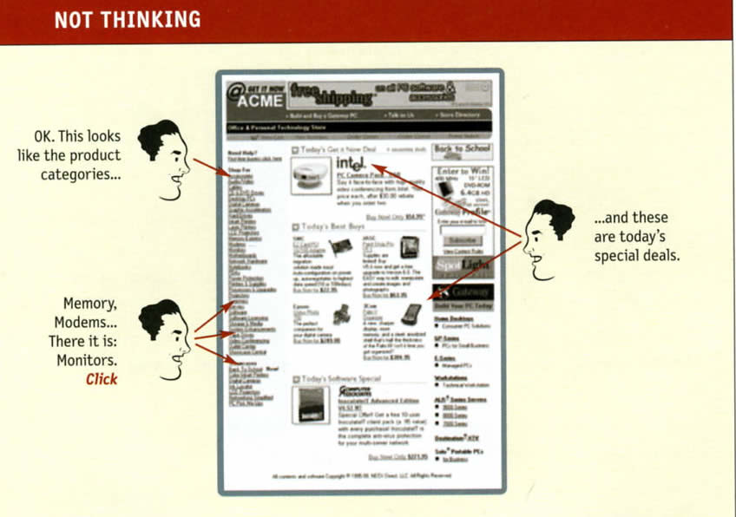

Slide 5
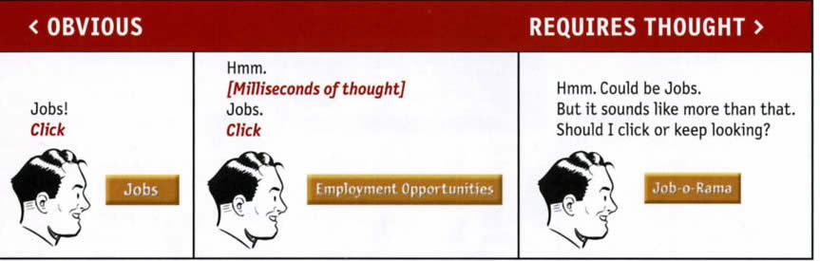
Things that make us think

Slide 6
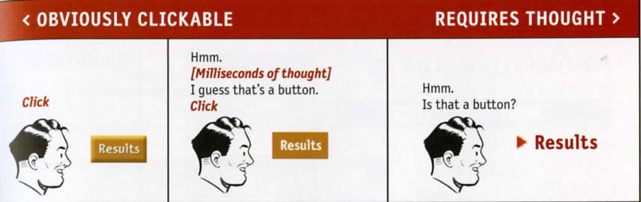
More things that make us think

Slide 7
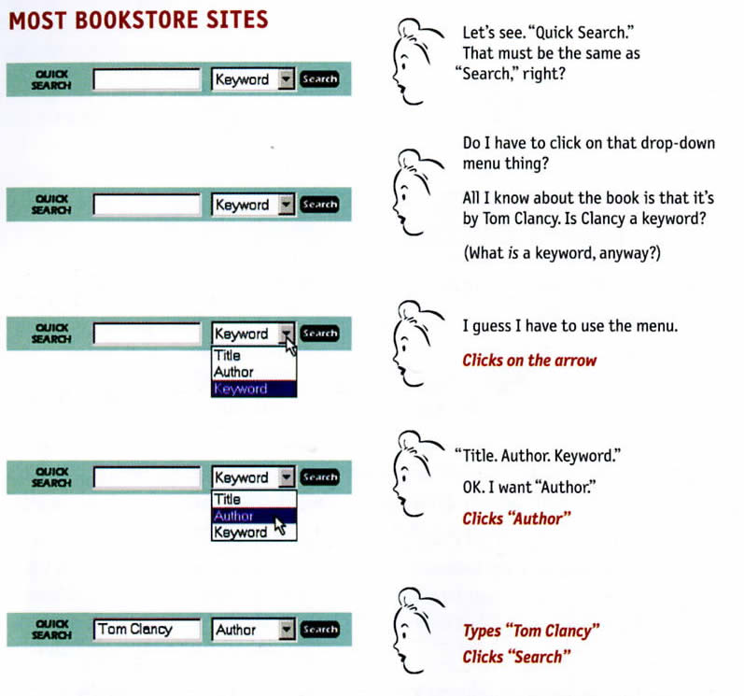

Slide 8
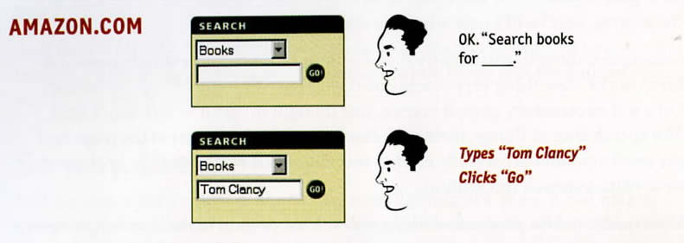
Amazon.com

Slide 9
How we really use the web
“In the past ten years, I’ve spent a lot of time watching people use the Web, and the thing that has struck me most is the difference between how we think people use Web sites and how they actually use them.” Krug, p.21

Slide 10
Web Use: The reality
We create as though people will pore over every detail: reading, figuring out organization, weighing options before clicking.
Reality = glance at each new page, scan some of the text, click first link that catches interest or vaguely resembles what we’re looking for.

Slide 11
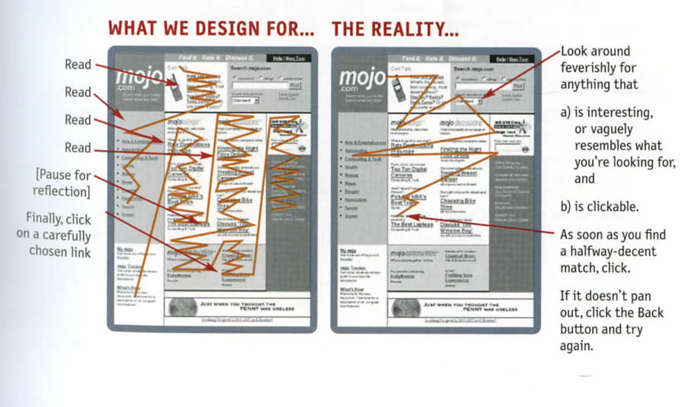

Slide 12
We don’t read pages. We scan them.
Usually in a hurry
Don’t need to know everything
Good at it.
Experienced with newspapers, magazines, books

Slide 13
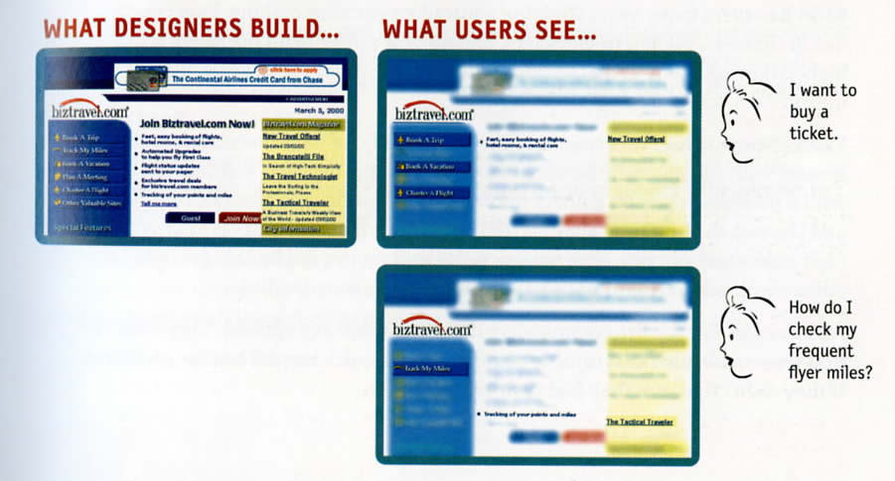

Slide 14
Users choose 1st reasonable option
In a hurry
Not much penalty for guessing wrong
Weighing options may not improve chances
Guessing is fun
  Krug, p.25

Slide 15
“We don’t figure things out. We muddle through.” Krug p. 26
Few people take time to read instructions.
Most just charge on ahead

Slide 16
Why does this happen?
For most people, it’s not important to know how things work.
If we find a way to make something work, even if it’s wrong, we stick to it.

Slide 17
“If your audience is going to act like you’re designing billboards, then design great billboards.”
-Krug, p. 29

Slide 18
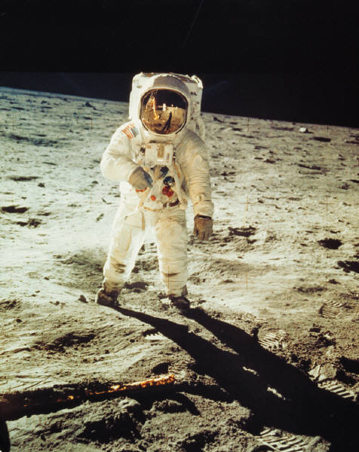
Begin designing for this kind of user.

Slide 19
Works Cited
Krug, Steve. Don’t Make Me Think! A Common Sense Approach to Web Usability, 2nd Edition. Berkley, CA: New Riders, 2006
The ideas in this show are either direct quotes from Krug or paraphrased ideas.

